Slide 1


INSERT THE TITLE
OF YOUR PRESENTATION HERE
TechGuruPlus.com _ Free PowerPoint Templates
Logo Here
FREE PPT TEMPLATES
BY TECHGURUPLUS.COM

Slide 2

FREE PROFESSIONAL TEMPLATES
ENTER YOUR TITLE
This PowerPoint Template has clean and neutral design that can be adapted to any content and meets various market segments. With this many slides you are able to make a complete PowerPoint Presentation that best suit your needs.
This PowerPoint Template has clean and neutral design that can be adapted to any content and meets various market segments. With this many slides you are able to make a complete PowerPoint Presentation that best suit your needs.
This PowerPoint Template has clean and neutral design that can be adapted to any content and meets various market segments. With this many slides you are able to make a complete PowerPoint Presentation that best suit your needs.
Image 1

Slide 3
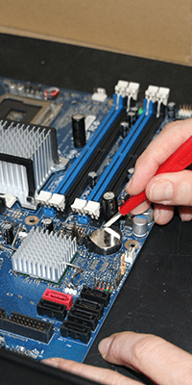
FREE PROFESSIONAL TEMPLATES
ENTER YOUR TITLE
This PowerPoint Template has clean and neutral design that can be adapted to any content and meets various market segments. With this many slides you are able to make a complete PowerPoint Presentation that best suit your needs.
This PowerPoint Template has clean and neutral design that can be adapted to any content and meets various market segments. With this many slides you are able to make a complete PowerPoint Presentation that best suit your needs.
This PowerPoint Template has clean and neutral design that can be adapted to any content and meets various market segments. With this many slides you are able to make a complete PowerPoint Presentation that best suit your needs.
Image 2

Slide 4

FREE PROFESSIONAL TEMPLATES
ENTER YOUR TITLE
This PowerPoint Template has clean and neutral design that can be adapted to any content and meets various market segments. With this many slides you are able to make a complete PowerPoint Presentation that best suit your needs.
This PowerPoint Template has clean and neutral design that can be adapted to any content and meets various market segments. With this many slides you are able to make a complete PowerPoint Presentation that best suit your needs.
This PowerPoint Template has clean and neutral design that can be adapted to any content and meets various market segments. With this many slides you are able to make a complete PowerPoint Presentation that best suit your needs.
Image 3

Slide 5


THE IMPORTANCE OF ONGOING BUSINESS PLANNING
Most potential investors will want to see a business plan before they consider funding your business. Although many businesses are tempted to use their business plans solely for this purpose, a good plan should set the course of a business over its lifespan.
A business plan plays a key role in allocating resources throughout a business. It is a tool that can help you attract new funds or that you can use as a strategy document. A good business plan reveals how you would use the bank loan or investment you are asking for.
Ongoing business planning means that you can monitor whether you are achieving your business objectives. A business plan can be used as a tool to identify where you are now and in which direction you wish your business to grow. A business plan will also ensure that you meet certain key targets and manage business priorities
WHAT YOUR BUSINESS PLAN SHOULD INCLUDE
Your business plan should include a summary of what your business does, how it has developed and where you want it to go. In particular, it should cover your strategy for improving your existing sales and processes to achieve the growth you desire.
You also need to make it clear what timeframe the business plan covers - this will typically be for the next 12 to 24 months.

Slide 6
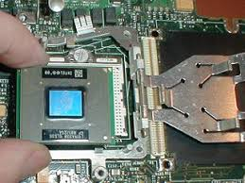
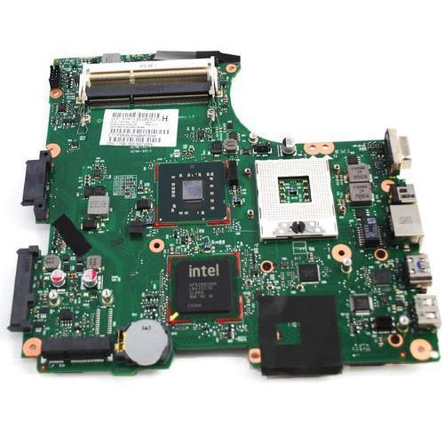
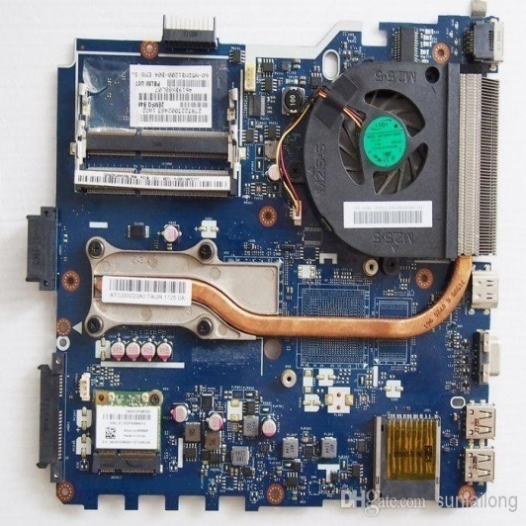
Processor
Mother Board
Board with Fan

Slide 7

Meet Our Team
We thrive on producing simple, elegant solutions to complex problems. Simplicity is central to every stage of a Castus project from planning through to design and development. We want your customers to get a great first impression of your company the second they land on your website, and for your customers to have an engaging and fulfilling experience when dealing with your company online.
In summary, we've got the skills and experience to make your online Endeavour a success. We've been doing it for eleven years for our clients, just take a look at our portfolio. We'd love to get involved with your next project, whatever it may be online, we're confident we can add value.

Slide 8






: Follow Us :
https://twitter.com/TechGuruPlus
https://www.youtube.com/nazimkhan09
https://www.facebook.com/TechGuruPlus
https://www.instagram.com/TechGuruPlus
+91 5566778899
https://in.linkedin.com/in/techguruplus

Slide 9



A perfect blend of creativity and technical wizardry. The best people formula for great websites!
GARY HIDES
TECHNICAL DIRECTOR
CHRIS SHORTER
COMMERICAL MANAGER
NATALIE WILLIAMS
PROJECT MANAGER

Slide 10


Logo Here
TechGuruPlus.com
Nazim Khan
OKHLA INDUSTRIAL AREA, PHASE-1,
NEW DELHI - 110020

